Slide 1
Towards Knowledge-Based Personalized Product Description
Generation in E-commerce
ADVISOR: JIA-LING, KOH
SOURCE: KDD ’19
SPEAKER: kuan-yu, sheng
DATE: 2020/09/15

Slide 2
Outline
Introduction
Method
Experiment
Conclusion

Slide 3
Introduction
3
Tedious
Time-consuming
Personalized product description

Slide 4
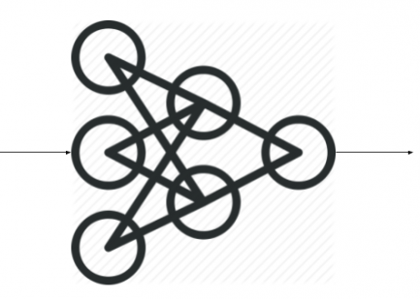
Introduction
4
Knowledge Based Personalized product description generation model
Tedious
Time-consuming
Personalized product description

Slide 5
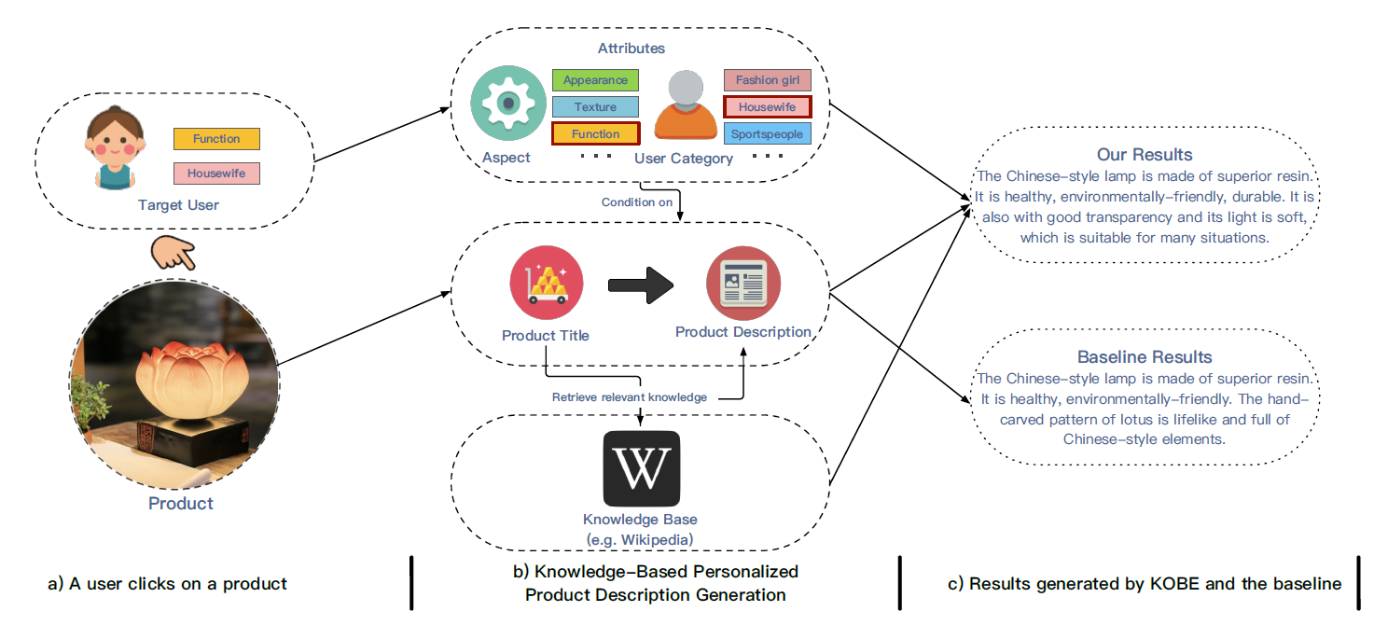
Introduction
5

Slide 6
Outline
Introduction
Method
Experiment
Conclusion

Slide 7
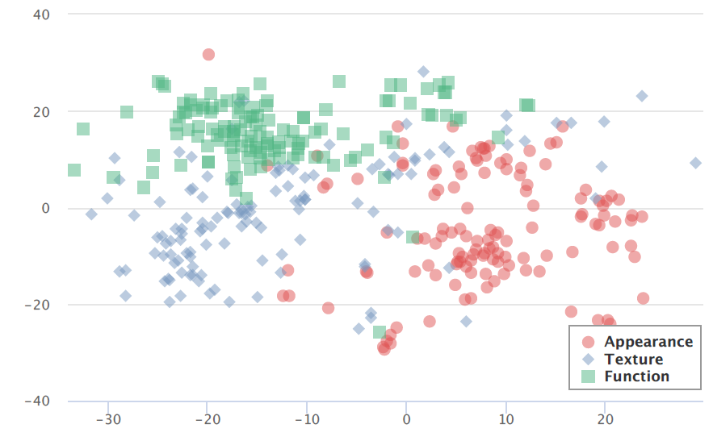
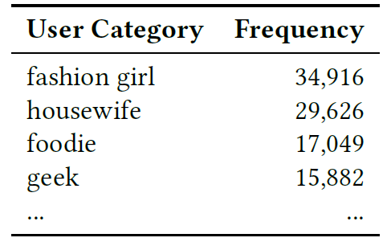
Method
Problem Formulation
Attribute A define (from discription): There are l attribute sets A1, . . . ,Al
A1 : aspects
by semantic similarity
|A1| = 3 , ( Appearance , Texture , Function)
A2 : user categories
Train a CNN model on dataset Z , use it to label.
|A2| = 24 , (fational girl, housewife….)
Notes:
A1再圖4有
A1 = 3
A2 = 24

Slide 8
Method
Problem Formulation
Knowledge W define : sequence of words w = (w1 , w2 , ……, wn)
|W| = 5 , randomly chosen from knowledge set (w1,w2…wj)
Title Sequence
(t1,t2…tn)
Entity set
(v1,v2…vm)
knowledge set
(w1,w2…wj)
Notes:
A1再圖4有
A1 = 3
A2 = 24

Slide 9
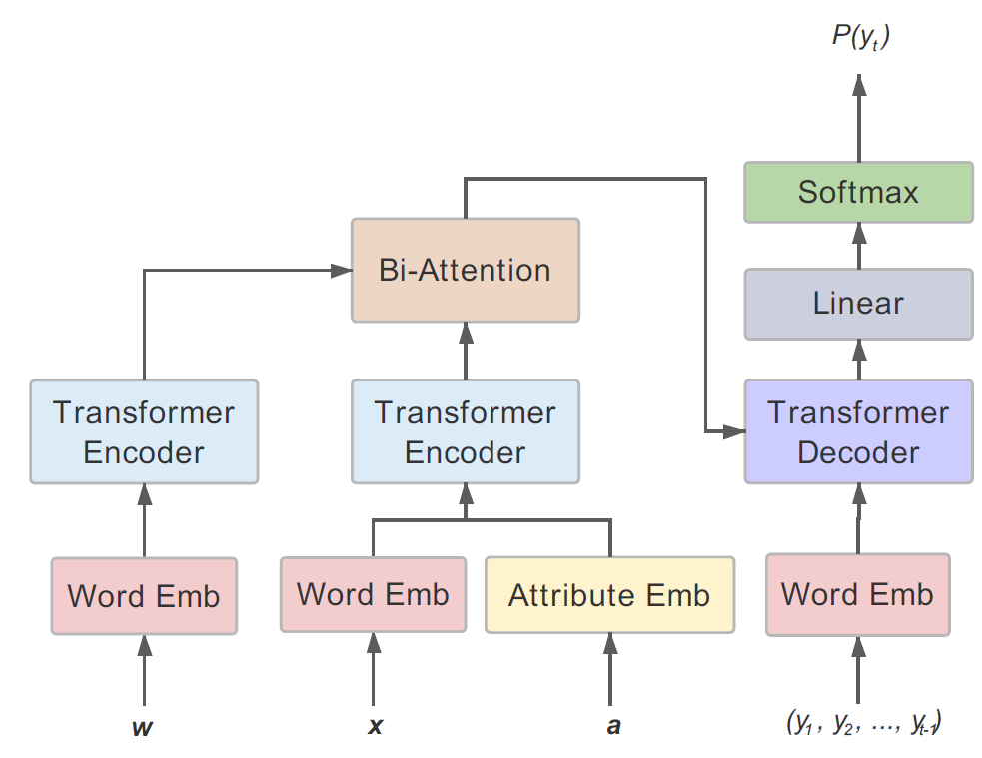
Method
Model overview
w : knowledge
x : title
a : attribute

Slide 10
Method
Transformer – Self Attention
$$q^{i}=W^{q}a^{i}$$
$q$: query (to match others)
$k$: key (to be matched)
$$k^{i}=W^{k}a^{i}$$
$v$: information to be extracted
$$v^{i}=W^{v}a^{i}$$
$$q^{1}$$
$$k^{1}$$
$$v^{1}$$
$$q^{2}$$
$$k^{2}$$
$$v^{2}$$
$$q^{3}$$
$$k^{3}$$
$$v^{3}$$
$$q^{4}$$
$$k^{4}$$
$$v^{4}$$
$$a^{1}$$
$$a^{2}$$
$$a^{3}$$
$$a^{4}$$
以下投影片節錄自李弘毅老師的Transformer講解，若要看更完整的解說可自:https://www.youtube.com/watch?v=ugWDIIOHtPA&t=2615s

Slide 11
Method
Transformer – Self Attention
dot product
Scaled Dot-Product Attention:
$$α_{1,i}=q^{1}∙k^{i}/\sqrt{d}$$
d is the dim of $q$ and $k$
$$α_{1,1}$$
$$α_{1,2}$$
$$α_{1,3}$$
$$α_{1,4}$$
$$q^{1}$$
$$k^{1}$$
$$v^{1}$$
$$q^{2}$$
$$k^{2}$$
$$v^{2}$$
$$q^{3}$$
$$k^{3}$$
$$v^{3}$$
$$q^{4}$$
$$k^{4}$$
$$v^{4}$$
$$a^{1}$$
$$a^{2}$$
$$a^{3}$$
$$a^{4}$$
以下投影片節錄自李弘毅老師的Transformer講解，若要看更完整的解說可自:https://www.youtube.com/watch?v=ugWDIIOHtPA&t=2615s

Slide 12
Method
Transformer – Self Attention
$${\hat{α}}_{1,i}=exp\left(α_{1,i} \right)/\sum_{j}{exp\left(α_{1,j} \right)}$$
$${\hat{α}}_{1,1}$$
$${\hat{α}}_{1,2}$$
$${\hat{α}}_{1,3}$$
$${\hat{α}}_{1,4}$$
Soft-max
$$α_{1,1}$$
$$α_{1,2}$$
$$α_{1,3}$$
$$α_{1,4}$$
$$q^{1}$$
$$k^{1}$$
$$v^{1}$$
$$q^{2}$$
$$k^{2}$$
$$v^{2}$$
$$q^{3}$$
$$k^{3}$$
$$v^{3}$$
$$q^{4}$$
$$k^{4}$$
$$v^{4}$$
$$a^{1}$$
$$a^{2}$$
$$a^{3}$$
$$a^{4}$$
以下投影片節錄自李弘毅老師的Transformer講解，若要看更完整的解說可自:https://www.youtube.com/watch?v=ugWDIIOHtPA&t=2615s

Slide 13
Method
Transformer – Self Attention
Considering the whole sequence
$$b^{1}=\sum_{i}{{\hat{α}}_{1,i} ∗ v^{i} }$$
$$b^{1}$$
$${\hat{α}}_{1,1}$$
$${\hat{α}}_{1,2}$$
$${\hat{α}}_{1,3}$$
$${\hat{α}}_{1,4}$$
$$q^{1}$$
$$k^{1}$$
$$v^{1}$$
$$q^{2}$$
$$k^{2}$$
$$v^{2}$$
$$q^{3}$$
$$k^{3}$$
$$v^{3}$$
$$q^{4}$$
$$k^{4}$$
$$v^{4}$$
$$a^{1}$$
$$a^{2}$$
$$a^{3}$$
$$a^{4}$$
以下投影片節錄自李弘毅老師的Transformer講解，若要看更完整的解說可自:https://www.youtube.com/watch?v=ugWDIIOHtPA&t=2615s

Slide 14
Method
Transformer – Self Attention
$$b^{2}$$
$$b^{2}=\sum_{i}{{\hat{α}}_{2,i}v^{i} }$$
$${\hat{α}}_{2,1}$$
$${\hat{α}}_{2,2}$$
$${\hat{α}}_{2,3}$$
$${\hat{α}}_{2,4}$$
$$q^{1}$$
$$k^{1}$$
$$v^{1}$$
$$q^{2}$$
$$k^{2}$$
$$v^{2}$$
$$q^{3}$$
$$k^{3}$$
$$v^{3}$$
$$q^{4}$$
$$k^{4}$$
$$v^{4}$$
$$a^{1}$$
$$a^{2}$$
$$a^{3}$$
$$a^{4}$$
以下投影片節錄自李弘毅老師的Transformer講解，若要看更完整的解說可自:https://www.youtube.com/watch?v=ugWDIIOHtPA&t=2615s

Slide 15
Method
Transformer – Self Attention
$b^{1}$, $b^{2}$, $b^{3}$, $b^{4}$ can be parallelly computed.
$$b^{1}$$
$$b^{2}$$
$$b^{3}$$
$$b^{4}$$
Self-Attention Layer
$$a^{1}$$
$$a^{2}$$
$$a^{3}$$
$$a^{4}$$
以下投影片節錄自李弘毅老師的Transformer講解，若要看更完整的解說可自:https://www.youtube.com/watch?v=ugWDIIOHtPA&t=2615s

Slide 16
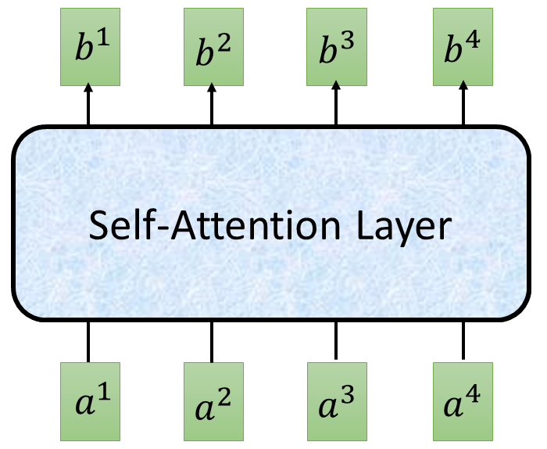
Method
Transformer – Self Attention
$$O$$
$$Q$$
=
$$I$$
$$W^{q}$$
$$K$$
=
$$I$$
$$W^{k}$$
$$V$$
=
$$W^{v}$$
$$I$$
$$I$$
$$\hat{A}$$
$$A$$
=
$$Q$$
$$K^{T}$$
$$\hat{A}$$
$$O$$
=
$$V$$
以下投影片節錄自李弘毅老師的Transformer講解，若要看更完整的解說可自:https://www.youtube.com/watch?v=ugWDIIOHtPA&t=2615s

Slide 17
Method
Multi-head Self Attention (2 heads as example)
$$b^{i,1}$$
$$q^{i,1}=W^{q,1}q^{i}$$
$$q^{i,2}=W^{q,2}q^{i}$$
$$q^{i,1}$$
$$q^{i,2}$$
$$k^{i,1}$$
$$k^{i,2}$$
$$v^{i,1}$$
$$v^{i,2}$$
$$q^{j,1}$$
$$q^{j,2}$$
$$k^{j,1}$$
$$k^{j,2}$$
$$v^{j,1}$$
$$v^{j,2}$$
$$q^{i}$$
$$k^{i}$$
$$v^{i}$$
$$q^{j}$$
$$k^{j}$$
$$v^{j}$$
$$q^{i}=W^{q}a^{i}$$
$$a^{i}$$
$$a^{j}$$
以下投影片節錄自李弘毅老師的Transformer講解，若要看更完整的解說可自:https://www.youtube.com/watch?v=ugWDIIOHtPA&t=2615s

Slide 18
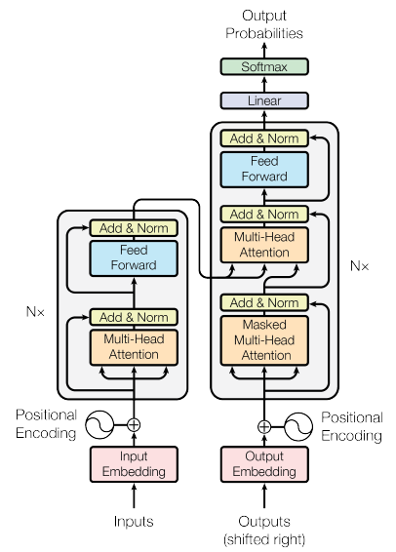
Method
Transformer
Encoder
Decoder
以下投影片節錄自李弘毅老師的Transformer講解，若要看更完整的解說可自:https://www.youtube.com/watch?v=ugWDIIOHtPA&t=2615s

Slide 19
Method
Transformer - Encoder
Layer
Norm
$$b^{′}$$
Encoder
+
Batch Size
$$b$$
Batch
$$μ=0,σ=1$$
…
$$a$$
Layer
$$μ=0,σ=1$$
以下投影片節錄自李弘毅老師的Transformer講解，若要看更完整的解說可自:https://www.youtube.com/watch?v=ugWDIIOHtPA&t=2615s

Slide 20
Method
Knowledge Encoding & sinusoidal positional encoding
PE( pos,2i ) = sin( pos/ ${10000}^{2i/d_{model}}$​)
PE( pos,2i+1 ) = cos( pos/ ${10000}^{2i/d_{model}}$​)​
Knowledge representation h
h
pos : the position of the word in the sequence.
i : the position in the vector.
$d_{model}$ : the dimention of the vector.
pos : 1
$d_{model}$ : 512
PE( 1,2i ) = sin( 1/${10000}^{2i/512}$​)
PE( 1,2i+1 ) = cos( 1/${10000}^{2i/512}$​)​
w = (w1 , w2 , ……, wn)
PE(1)=[sin( 1/${10000}^{0/512}$​), cos( 1/${10000}^{1/512}$​)​, sin( 1/${10000}^{2/512}$​),​...]​

Slide 21
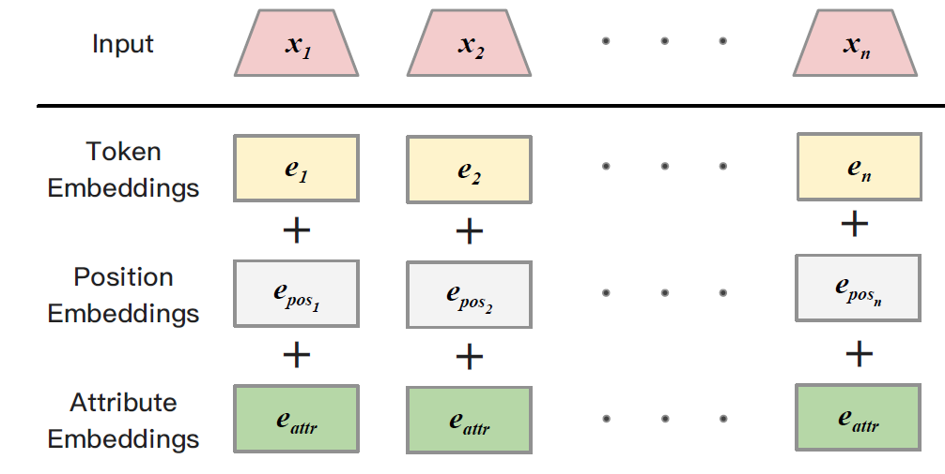
Method
Title & Attribute Encoding
Title & Attribute representation u
$$e_{a1}$$
A1
A2
$$e_{a2}$$
( $e_{a1}$ + $e_{a2}$ ) /2 = $e_{attr}$
u

Slide 22
Method
Bi-Attention – Title to Knowledge
Title
$$h_{1}$$
$$h_{2}$$
$$h_{3}$$
…
$$h_{i}$$
$$u_{1}$$
$$S_{1}$$
Bi-attention output
$$S_{2}$$
$$u_{2}$$
Knowledge
$$S_{3}$$
h
$$u_{3}$$
$$S_{k}$$
u
…
$$u_{k}$$
Title-to-Knowledge :
ai : attention weights on the knowledge words by the i-th title word

Slide 23
Method
Bi-Attention – Knowledge to Title
Title
$$h_{1}$$
$$h_{2}$$
$$h_{3}$$
…
$$h_{k}$$
$$u_{1}$$
$$S_{1,1}$$ | $$S_{1,2}$$ | $$S_{1,3}$$ |  | $$S_{1,4}$$
$$S_{2,1}$$ | $$S_{2,2}$$ | $$S_{2,3}$$ |  | $$S_{2,4}$$
$$S_{3,1}$$ | $$S_{3,2}$$ | $$S_{3,3}$$ |  | $$S_{3,4}$$
$$S_{i,1}$$ | $$S_{i,2}$$ | $$S_{i,3}$$ |  | $$S_{i,k}$$
Bi-attention output
$$u_{2}$$
Knowledge
h
$$u_{3}$$
u
…
$$u_{i}$$
max1
,max2,max3 ...maxi = $b_{k}$
Knowledge-to-Title :
ai : attention weights on the knowledge words by the i-th title word

Slide 24
Method
Bi-Attention – Knowledge to Title
Bi-attention output
Title-to-Knowledge :
h
u
Knowledge-to-Title :
Bi-attention output :

Slide 25
Method
Transformer - Decoder
Decoder
attend on the input sequence
Masked: attend on the generated sequence

Slide 26
Batch Size
Method
Transformer
Batch
$$μ=0,σ=1$$
Layer
Norm
$$b^{′}$$
+
Layer
$$μ=0,σ=1$$
$$b$$
attend on the input sequence
…
$$a$$
Masked: attend on the generated sequence
以下投影片節錄自李弘毅老師的Transformer講解，若要看更完整的解說可自:https://www.youtube.com/watch?v=ugWDIIOHtPA&t=2615s

Slide 27
Outline
Introduction
Method
Experiment
Conclusion

Slide 28
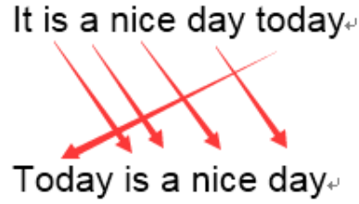
EXPERIMENT
28
Evaluation matrix
BLEU :
inout：今天天氣不錯
output：It is a nice day today
Groung-truth：Today is a nice day
BLEU Score = 5/6
Notes:
Wikipedia corpus
Wikidata knowledge base WKB

Slide 29
EXPERIMENT
29
Evaluation matrix
Lexical diversity:
diversity = len(text) / len(set(text))
calculate the number of distinct n-grams produced on the test set
Attribute Capturing:
Notes:
用詞多樣性 (存在文本中的n-gram相異個數)，越多代表多樣性越高
從生成的結果中利用CNN分類器想辦法找出所有attribute並與原本做比較。

Slide 30
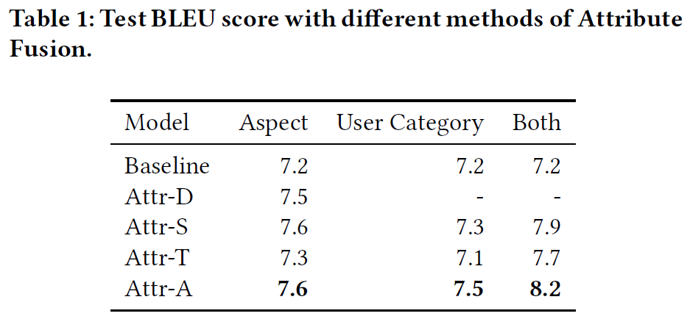
EXPERIMENT
30
Performance on dataset - BLEU
Notes:
Baseline: only teansformer
D : ‘appearance’,’texture,’function’分開來做，做完取平均
S : 將attribute變成特殊tag而非原本的embedding表示。
T : 將attribute Embedding取平均當作生成sequence開頭的表示。
A : 原本版

Slide 31
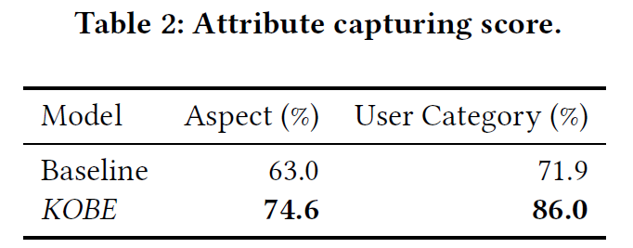
EXPERIMENT
31
Performance on dataset –Attr Capture
Notes:
比Baseline生成的更能夠完整包含原本input的attribute

Slide 32
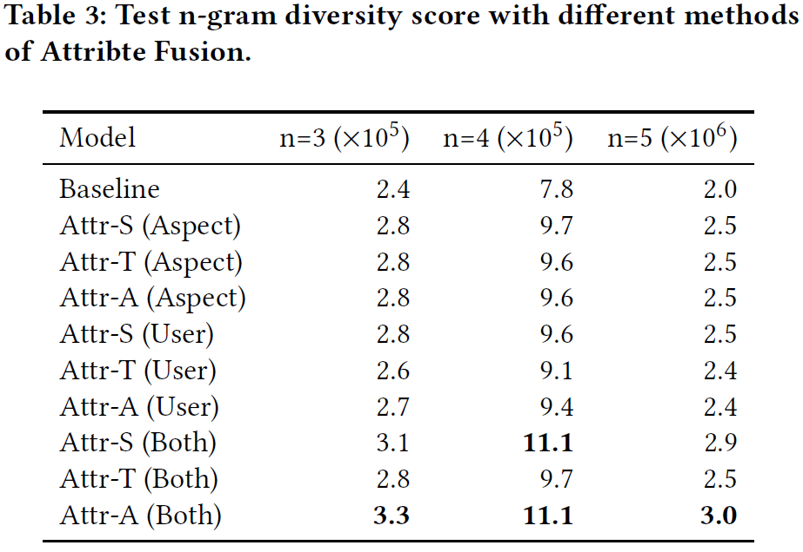
EXPERIMENT
32
Performance on dataset – diversity
Notes:
Wikipedia corpus
Wikidata knowledge base WKB

Slide 33
EXPERIMENT
33
Performance on dataset – diversity
Notes:
明顯提升用詞多樣性

Slide 34
EXPERIMENT
34
Performance on dataset –human judgment
Notes:
Wikipedia corpus
Wikidata knowledge base WKB

Slide 35
Outline
Introduction
Method
Experiment
Conclusion

Slide 36
Conclusion
Proposing a novel model based on the Transformer framework which including product aspects, user categories, as well as the knowledge base.
The experiments show that this method outperforms the baseline models through a series of evaluations, including automatic evaluation and human evaluation.

